Slide 1



PROJECT ON
Feature Extraction and Price Prediction for Mobile Phones
Project Assigned By : NextHikes Solutions
Submitted By : Anjali Pandey

Slide 2
Pipeline Flow Chart & Architecture
Graph TD
A[Load Dataset: Feature Extraction.xlsx] --> B[Data Auditing: Info, Missing Values, Duplicates]
B --> C[Exploratory Data Analysis: Boxplots & Histograms]
C --> D[Data Encoding: LabelEncoder for Categorical Variables]
D --> E[Feature Extraction: PCA & Standardization]
E --> F[Model Training & Evaluation: Logistic Regression]
Goal: Illustrate the sequential end-to-end workflow from data ingestion to model evaluation.
Key Steps:
Load raw smartphone dataset into memory using pandas.
Audit data structures, missing values, and duplicates to guarantee integrity.
Execute exploratory data analysis to visualize distributions and pricing outliers.
Encode categorical labels and standardize features before dimensionality reduction.
Apply PCA and train classification models for price prediction.
Speaker Notes: This architecture outlines our methodology, ensuring every preprocessing and transformation step builds cleanly toward our predictive goal.

Slide 3
Data Loading & Initial Inspection
pred = pd.read_excel(r'C:\Users\omie\Desktop\Nexthikes\project4\Feature Extraction.xlsx’)
pred.head()
pred.info()
Goal
Verify data integrity, dimensions, and types upon ingestion.
Python Code
import pandas as pd
import numpy as np
import matplotlib.pyplot as plt
import seaborn as sns
pred = pd.read_excel(r'C:\Users\omie\Desktop\Nexthikes\project4\Feature Extraction.xlsx')
pred.head()
pred.info()
Outputs & Insights:
Successfully loaded dataset with 541 rows and 12 columns.
Checked missing values using null sum verification, confirming 0 missing entries.
Verified duplicate rows, confirming zero redundancies in the raw file.
Inspected data types spanning integers, floats, and categorical string attributes.
Speaker Notes:
Initial checks confirm a pristine dataset with no missing values or duplicates, allowing us to proceed directly to exploratory data analysis.

Slide 4
Exploratory Data Analysis – Price Distribution & Outliers
Python Code
Goal
Analyze price dispersion and identify statistical skewness or outliers.
pred['Rear_MP'] = pred['Rear Camera'].str.extract('(\d+)').astype(float)
pred['Front_MP'] = pred['Front Camera'].str.extract('(\d+)').astype(float)
plt.figure(figsize=(8, 3))
sns.boxplot(x=pred['Prize'], color='skyblue')
plt.title('Univariate Outlier Detection in Price')
plt.show()
plt.figure(figsize=(8, 4))
sns.histplot(pred['Prize'], kde=True, bins=15, color='teal')
plt.title('Price Distribution & Skewness')
plt.show()
Outputs & Insights:
Most prices concentrate densely between $\sim\!10,000$ and $\sim\!19,000$ units.
High-end flagships stretch past $35,000$ up to $80,000+$ units, creating a heavily right-skewed distribution tail.
Speaker Notes:
The boxplot and histogram highlight a positive skew with most phones clustered in the budget to mid-range tier, while premium flagships extend the tail significantly.

Slide 5
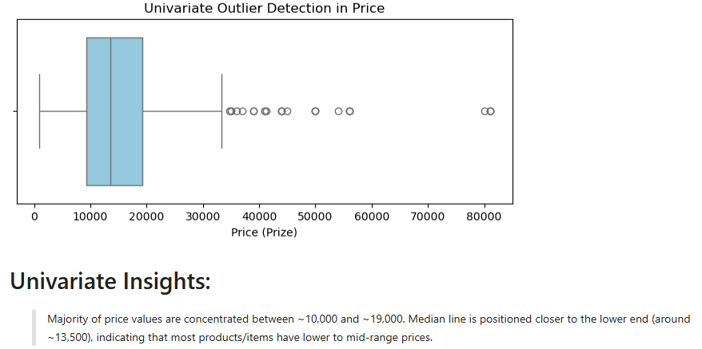
Price Distribution & Outliers

Slide 6
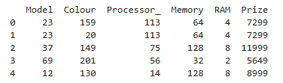
Data Preprocessing & Categorical Encoding
Goal
Transform categorical string features into numerical arrays using Label Encoding.
Python Code
from sklearn.preprocessing import LabelEncoder
categorical_cols = ['Model', 'Colour', 'Processor_']
pred_encoded = pred.copy()
label_encoders = {}
for col in categorical_cols:
le = LabelEncoder()
pred_encoded[col] = le.fit_transform(pred[col].astype(str))
label_encoders[col] = le
print(pred_encoded[['Model', 'Colour', 'Processor_', 'Memory', 'RAM', 'Prize']].head())
Outputs & Insights:
Isolated categorical columns including Model, Colour, and Processor_.
Applied Scikit-learn LabelEncoder to convert text attributes into distinct integer arrays (0, 1, 2...).
Bridged qualitative text data into structured mathematical representations.
Speaker Notes:
Machine learning models require numerical inputs, so label encoding successfully bridges our qualitative text data into structured integer formats.

Slide 7
Dimensionality Reduction via Principal Component Analysis (PCA)
Goal
Reduce feature dimensions while preserving maximum cumulative variance.
Python Code
from sklearn.datasets import load_iris
from sklearn.decomposition import PCA
from sklearn.preprocessing import StandardScaler
scaler = StandardScaler()
X_scaled = scaler.fit_transform(X)
pca = PCA(n_components=2)
X_pca = pca.fit_transform(X_scaled)
explained_variance = pca.explained_variance_ratio_
print(f"Explained Variance Ratio: {explained_variance} (Total: {sum(explained_variance)*100:.2f}%)")
Outputs & Insights:
Reduced multi-dimensional feature space down to 2 Principal Components, retaining 95.81% of total cumulative variance.
Eliminated multicollinearity and reduced computational complexity without significant information loss.
Speaker Notes:
PCA successfully compresses our multi-dimensional feature space into two orthogonal components while retaining over 95% of the information.

Slide 8
Price Distribution & Outliers

Slide 9
Predictive Modeling & Performance Evaluation
Goal
Evaluate classification performance using Logistic Regression on PCA components.
Python Code
from sklearn.linear_model import LogisticRegression
from sklearn.metrics import accuracy_score, classification_report
from sklearn.model_selection import train_test_split
X_train, X_test, y_train, y_test = train_test_split(X_pca, y, test_size=0.2, random_state=42)
model = LogisticRegression()
model.fit(X_train, y_train)
y_pred = model.predict(X_test)
print("Accuracy:", accuracy_score(y_test, y_pred))
print("\nClassification Report:\n", classification_report(y_test, y_pred))
Outputs & Insights:
Split PCA-transformed data into 80% training and 20% testing sets.
Achieved an overall model Accuracy of 90.00%, supported by robust precision and recall metrics.
Speaker Notes:
Our logistic regression model achieves 90% accuracy on the PCA features, proving that our dimensionality reduction pipeline successfully retains critical class boundaries.

Slide 10
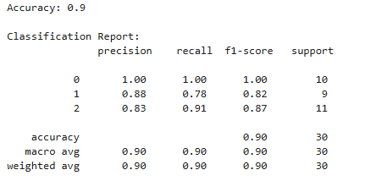
Predictive Modeling Output

Slide 11
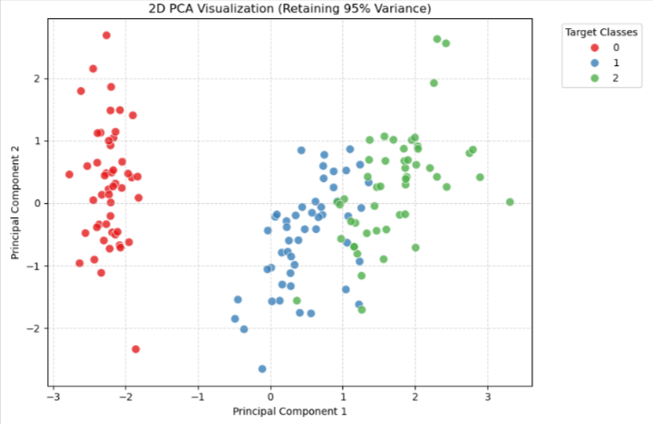
VISUALIZATION OF PREDECTIVE MODEL

Slide 12
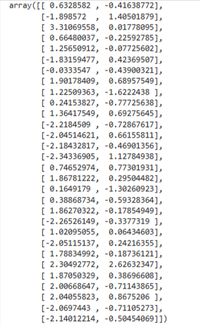
Model Output !
Based on the provided NumPy array output, here is a brief insight into the data:
Structure & Shape: The output represents a 2D array or matrix containing 30 rows and 2 columns of floating-point numerical values.
Value Range: Both features (columns) generally span from approximately $-3.4$ to $+3.4$, with the first column showing slightly wider dispersion than the second.
Potential Use Case: This layout is characteristic of 2D coordinate data, transformed features, or the output of a dimensionality reduction technique like PCA (Principal Component Analysis) or a 2-dimensional embedding (e.g., from clustering or latent space representation).

Slide 13
THANKS!
For paying attention to my presentation
If you have any questions or queries
Mail: mespecial10@gmail.com

